Slide 1


APPLICATION CHEMISTRY
A2 LEVEL
MATERIALS AND DESIGN
CHAPTER 2:
POLYMERS

Slide 2
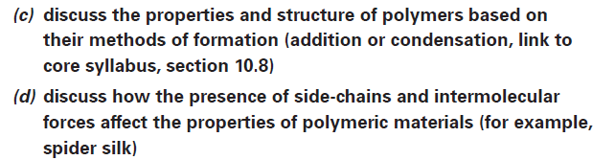
What you should know…

Slide 3
Addition Polymerisation
Polymers made from alkenes only contain carbon and hydrogen atoms.
The physical properties of polymers are determined by the van der Waals’ forces present in the polymer.
The properties of addition polymers can be modified in a number of ways.
Addition polymers tend to deform easily and once deformed do not return to their original shape.
Generally, the longer the polymer chains, the stronger the van der Waals’ forces.

Slide 4
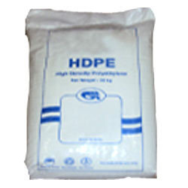
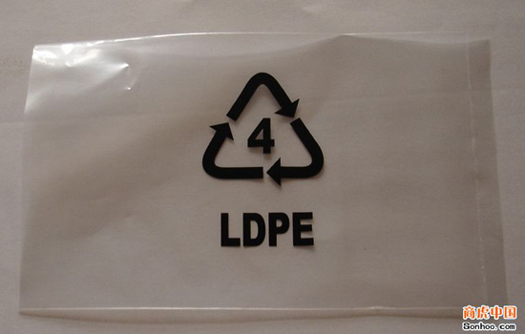
Addition Polymerisation
Generally, unbranched chains can pack together better than polymers with lots of side chains.
The “soft” bags are made from low density poly(ethene) (LDPE), which has lots of side chains and is relatively weak and easy to deform.
The type of bag that rustles is made from high density poly(ethene) (HDPE) which has fewer side chains.
Presence of chlorine atoms in poly(chloroethene) results in permanent dipole interactions between carbon and chlorine because of the polarity of the carbon-chlorine bond.

Slide 5
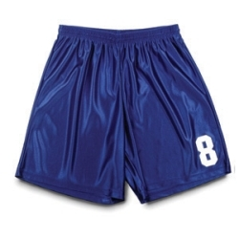
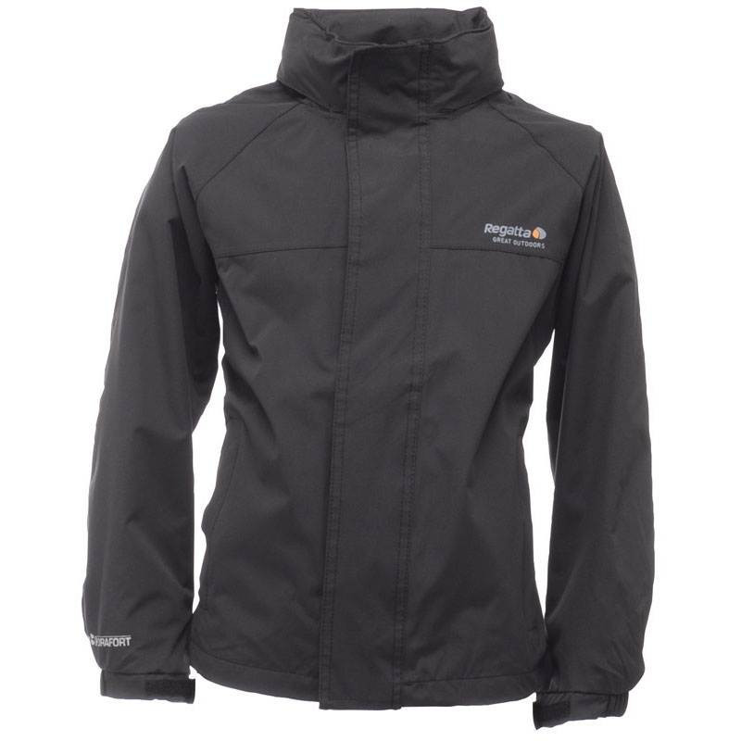
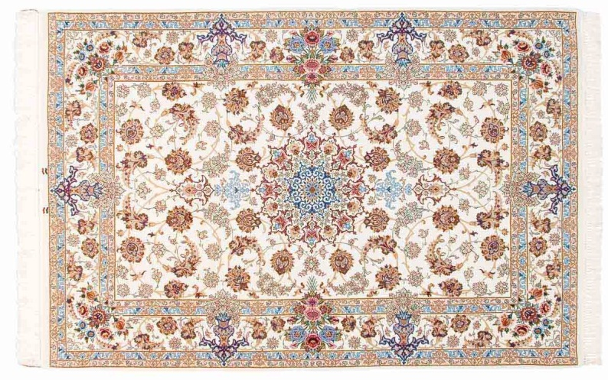
Condensation Polymerisation
Condensation polymerisation usually requires two different molecules that can react together to form an ester or amide bond with the elimination of a small molecule such as water.
Examples include synthetic polymers such as polyesters and polyamides as well as peptides and proteins.
Polyester is widely used to make a variety of items from drink bottles to clothing and carpeting.

Slide 6
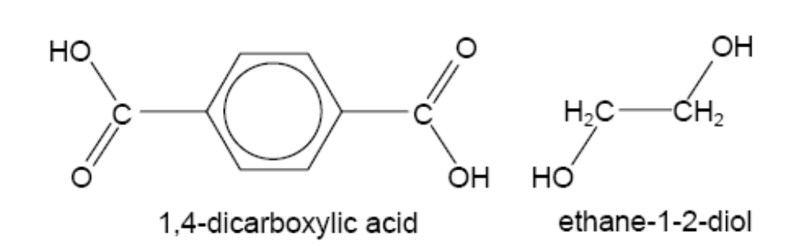
Condensation Polymerisation
Polymerising ethane-1-2-diol with 1,4-benzenedicarboxylic acid (terephthalic acid) with the elimination of water. The product is widely known as Terylene.

Slide 7
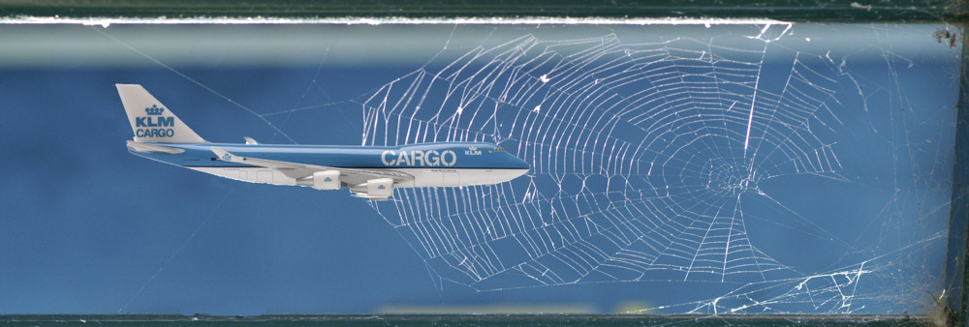
Spider Silk
Based on weight, spider silk is five times stronger than steel of the same diameter.
More recently, it has been suggested that a strand of spider silk as thick as a pencil would stop a jumbo jet in flight!
Spider silk is a protein that is in the same protein group as hair, nails and ligaments.
http://ednieuw.home.xs4all.nl/Spiders/Info/SilkBoeing.html

Slide 8
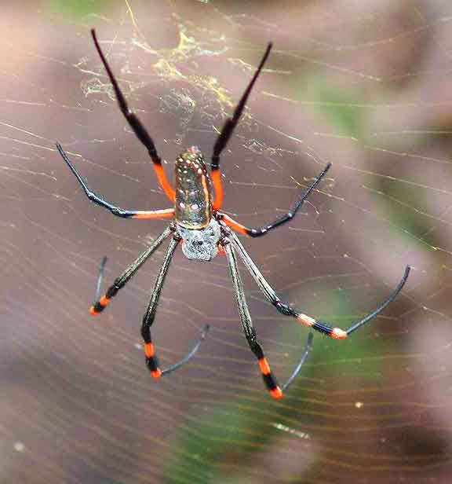
Spider Silk
The Golden Orb-Weaving spider produces a dragline silk (a dragline connects a spider to its web) that is the strongest form of spider silk.
The protein in dragline silk is called fibroin.
Fibroin has a molecular mass of 200 000 – 300 000 and consists of 42% glycine and 25% alanine, with the remainder coming from just seven other amino acids.
http://bobarno.com/thiefhunters/golden-orb-weaver-spider/

Slide 9
Spider Silk
The alanine molecules occur in polyalanine regions, where between 4 and 9 alanine molecules are linked in a block.
The elasticity of spider silk comes from regions that are rich in glycine. In these regions a sequence of five amino acids is repeated.
After each sequence a 180° turn occurs producing a spiral.
Ordinary silk, produced by silk moths has a β-pleated sheet structure, held together by hydrogen bonds

Slide 10
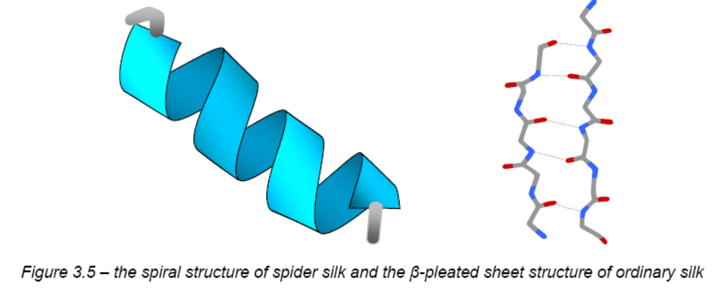
Spider Silk

Slide 11
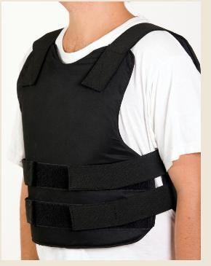
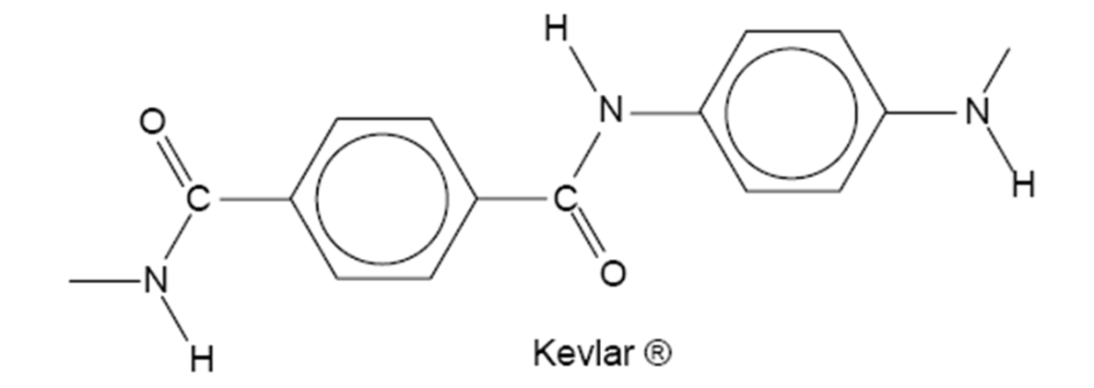
Spider Silk
The most elastic spider silk is ‘capture silk’ that has about 43 repeats and can extend to 200% of its length.
Clearly the properties of spider silk are very valuable and chemists are researching man-made polymers that have similar properties.
Kevlar® is used for bulletproof vests; re-enforcing Kevlar® with spider silk would make these vests even stronger.

Slide 12
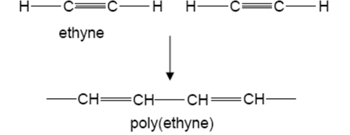
Plastics That Conduct Electricity Or Emit Light
Conducting polymers were discovered by accident by a Japanese student.
Are organic polymers that conduct electricity.
Polymerisation of ethyne (acetylene) produces poly(ethyne) by addition polymerisation.
This material has alternating single and double bonds. Poly(ethyne) has two forms, cis and trans.

Slide 13
Plastics That Conduct Electricity Or Emit Light
The two isomers have different colours,
  trans-poly(ethyne) is blue or silver coloured;
  cis-poly(ethyne) is red or copper coloured.
Molecules that have alternating single and double bonds have “conjugated systems
A conjugated system is a system of connected p-orbitals with delocalized electrons in compounds with alternating single and multiple bonds, which in general may lower the overall energy of the molecule and increase stability.
The realisation that trans-poly(ethyne) had conjugated π bonds led to the discovery that this polymer could conduct electricity!

Slide 14
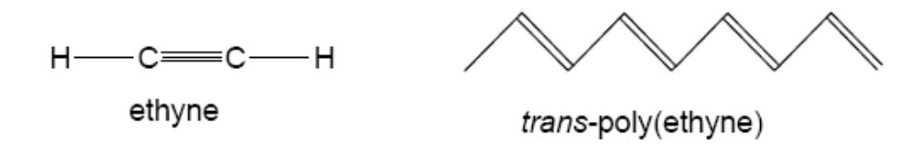
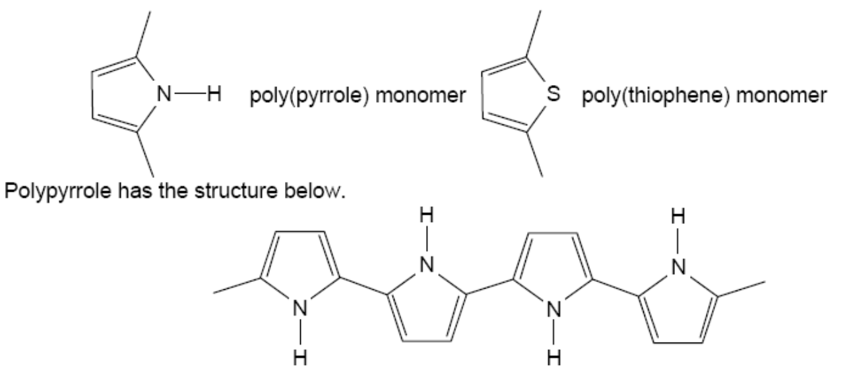
Plastics That Conduct Electricity Or Emit Light
The conjugated system in trans-poly(ethyne) is shown below.
Other conducting polymers include compounds such as poly(pyrrole) and poly(thiophene).
Technically, these conducting polymers are semi-conductors, unlike the nanotubes in the section on Nanotechnology.

Slide 15
Plastics That Conduct Electricity Or Emit Light
For these polymers to conduct, they need to be ‘doped’, meaning that some electrons are removed (by oxidation) or introduced (by reduction) leaving ‘holes’ allowing the electrons (or the ‘holes’) to flow.
Another use is ‘Smart’ windows that have been developed to reduce glare from sunlight.
The windows are coated with a conductive polymer in contact with a layer of black particles.
When current is passed through the polymer, these molecules particles align and let light through.
When the current is stopped, they become disordered and block light.

Slide 16
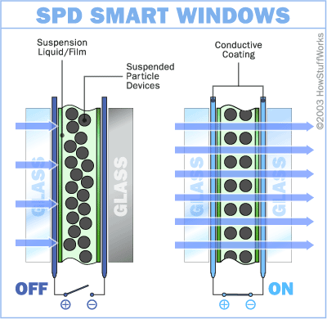
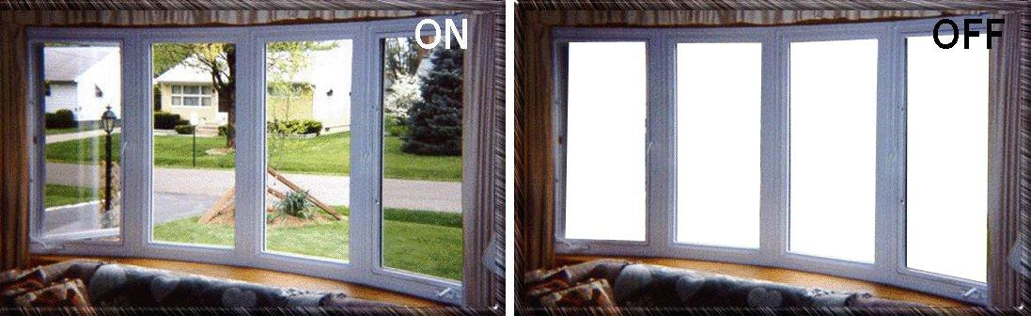

Slide 17
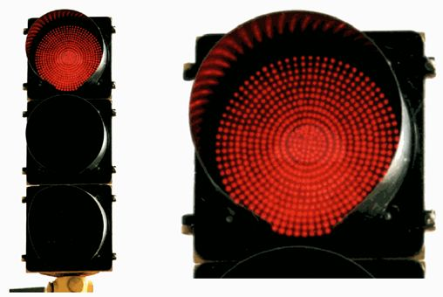
The traffic lights are changing
Traditionally, traffic lights have been lit with a single bulb that shines through coloured glass.
OLEDs - organic light emitting diodes.
If one of the OLEDs fail, there are still plenty left, so you will be able to cross on the green.

Slide 18
The traffic lights are changing
OLED displays are appearing in a number of applications.
For example Kodak have designed a camera with an OLED screen instead of a liquid crystal display screen.
OLED advantages
  it can be viewed even in sunlight as light is being emitted.
  wider viewing angle.
However, current OLEDs, particularly the blue ones, have a shorter lifetime than liquid crystal displays.

Slide 19
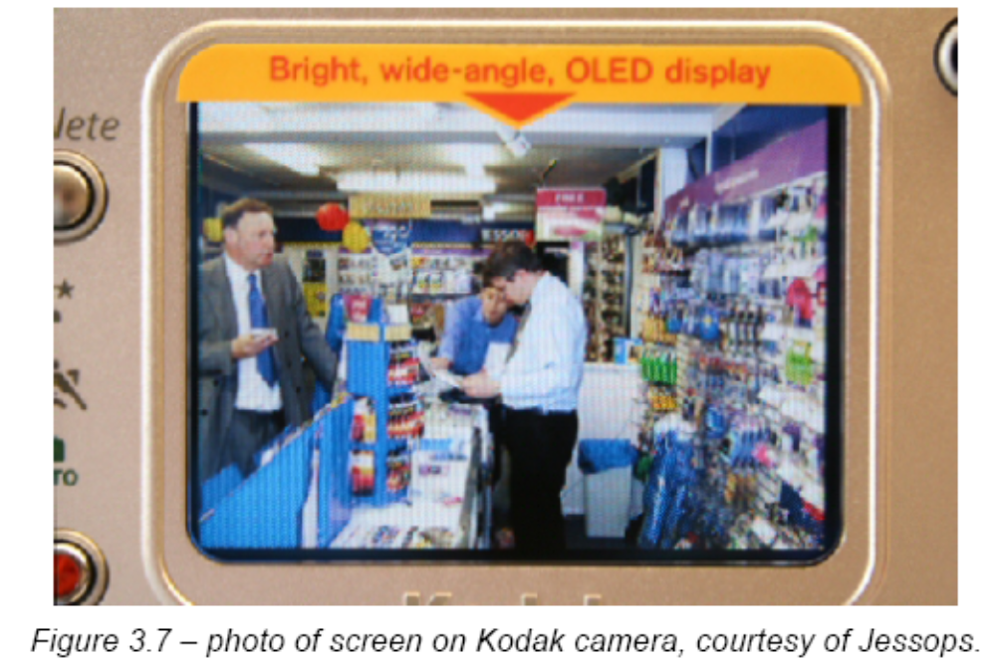
The traffic lights are changing

Slide 20
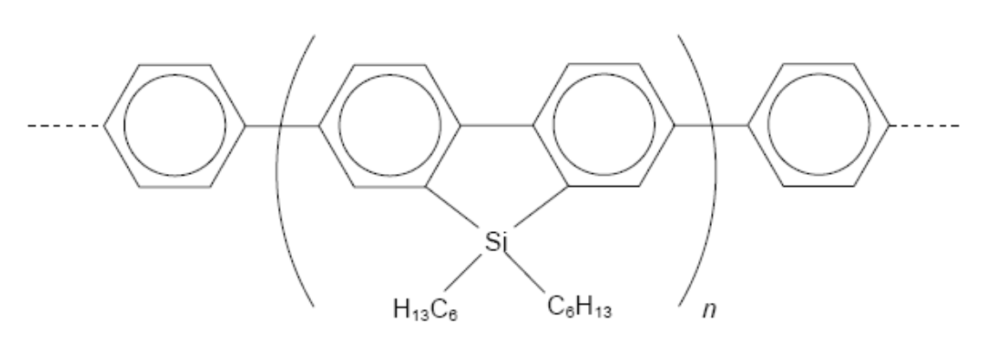
The traffic lights are changing
Research published in 2005 has found blue-emitting materials that may overcome the problem of the shorter lifespan of blue pixels in OLEDS compared to the red and green-emitting pixels in OLED displays.
A team from Cambridge in the UK created the blue-emitting polymer, shown below.

Slide 21
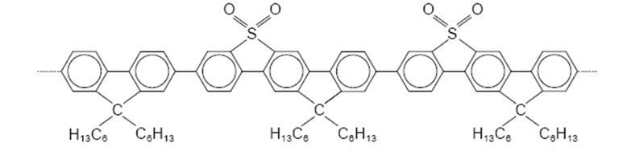
The traffic lights are changing
A second independent team, working between the Donetsk University in the Ukraine and the University of Durham, UK has discovered a similar blue-emitting material.
The structure of their polymer is shown below.

